Slide 1

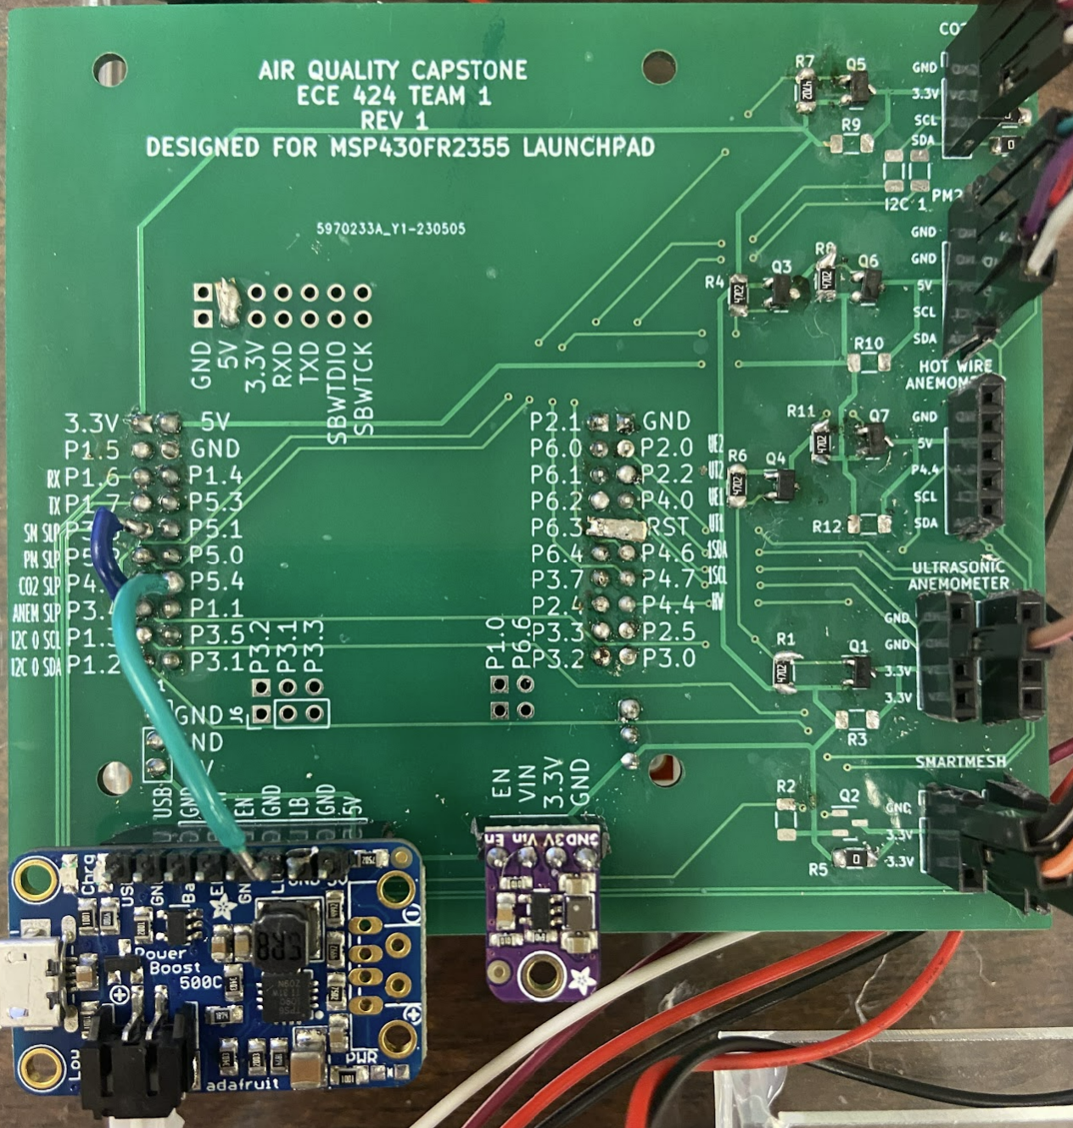
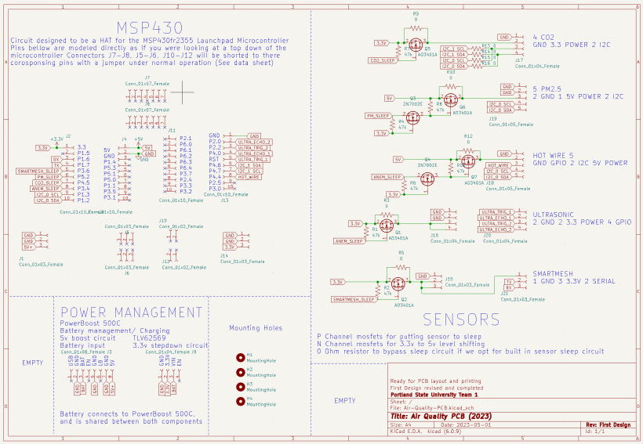
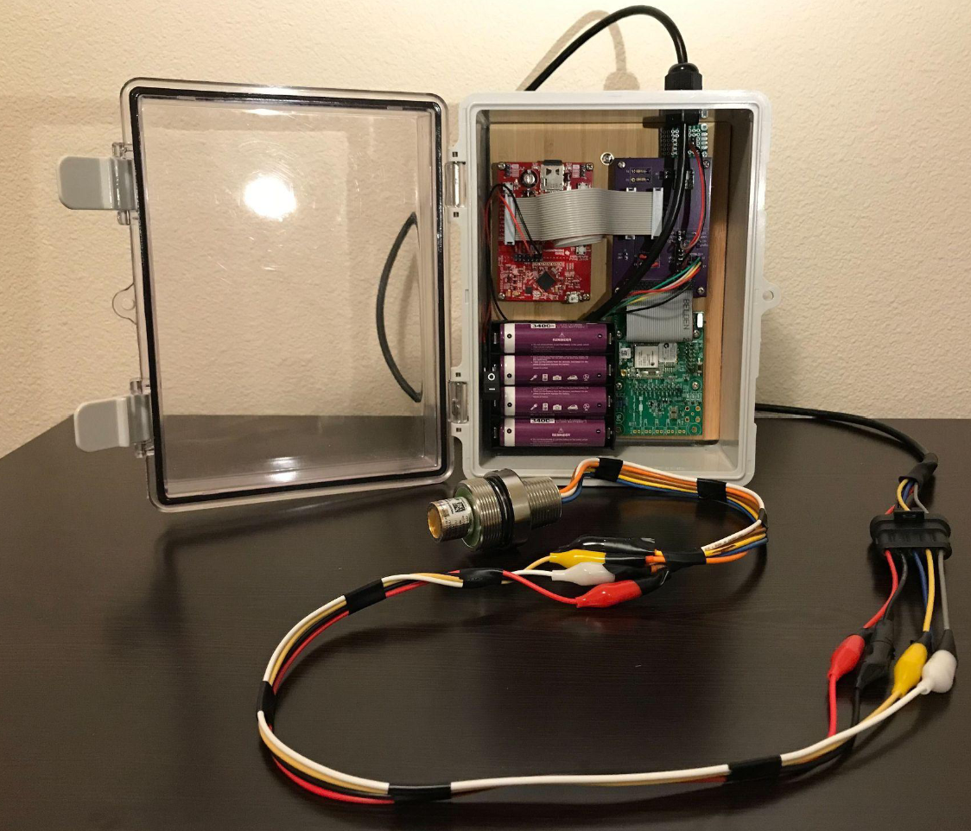
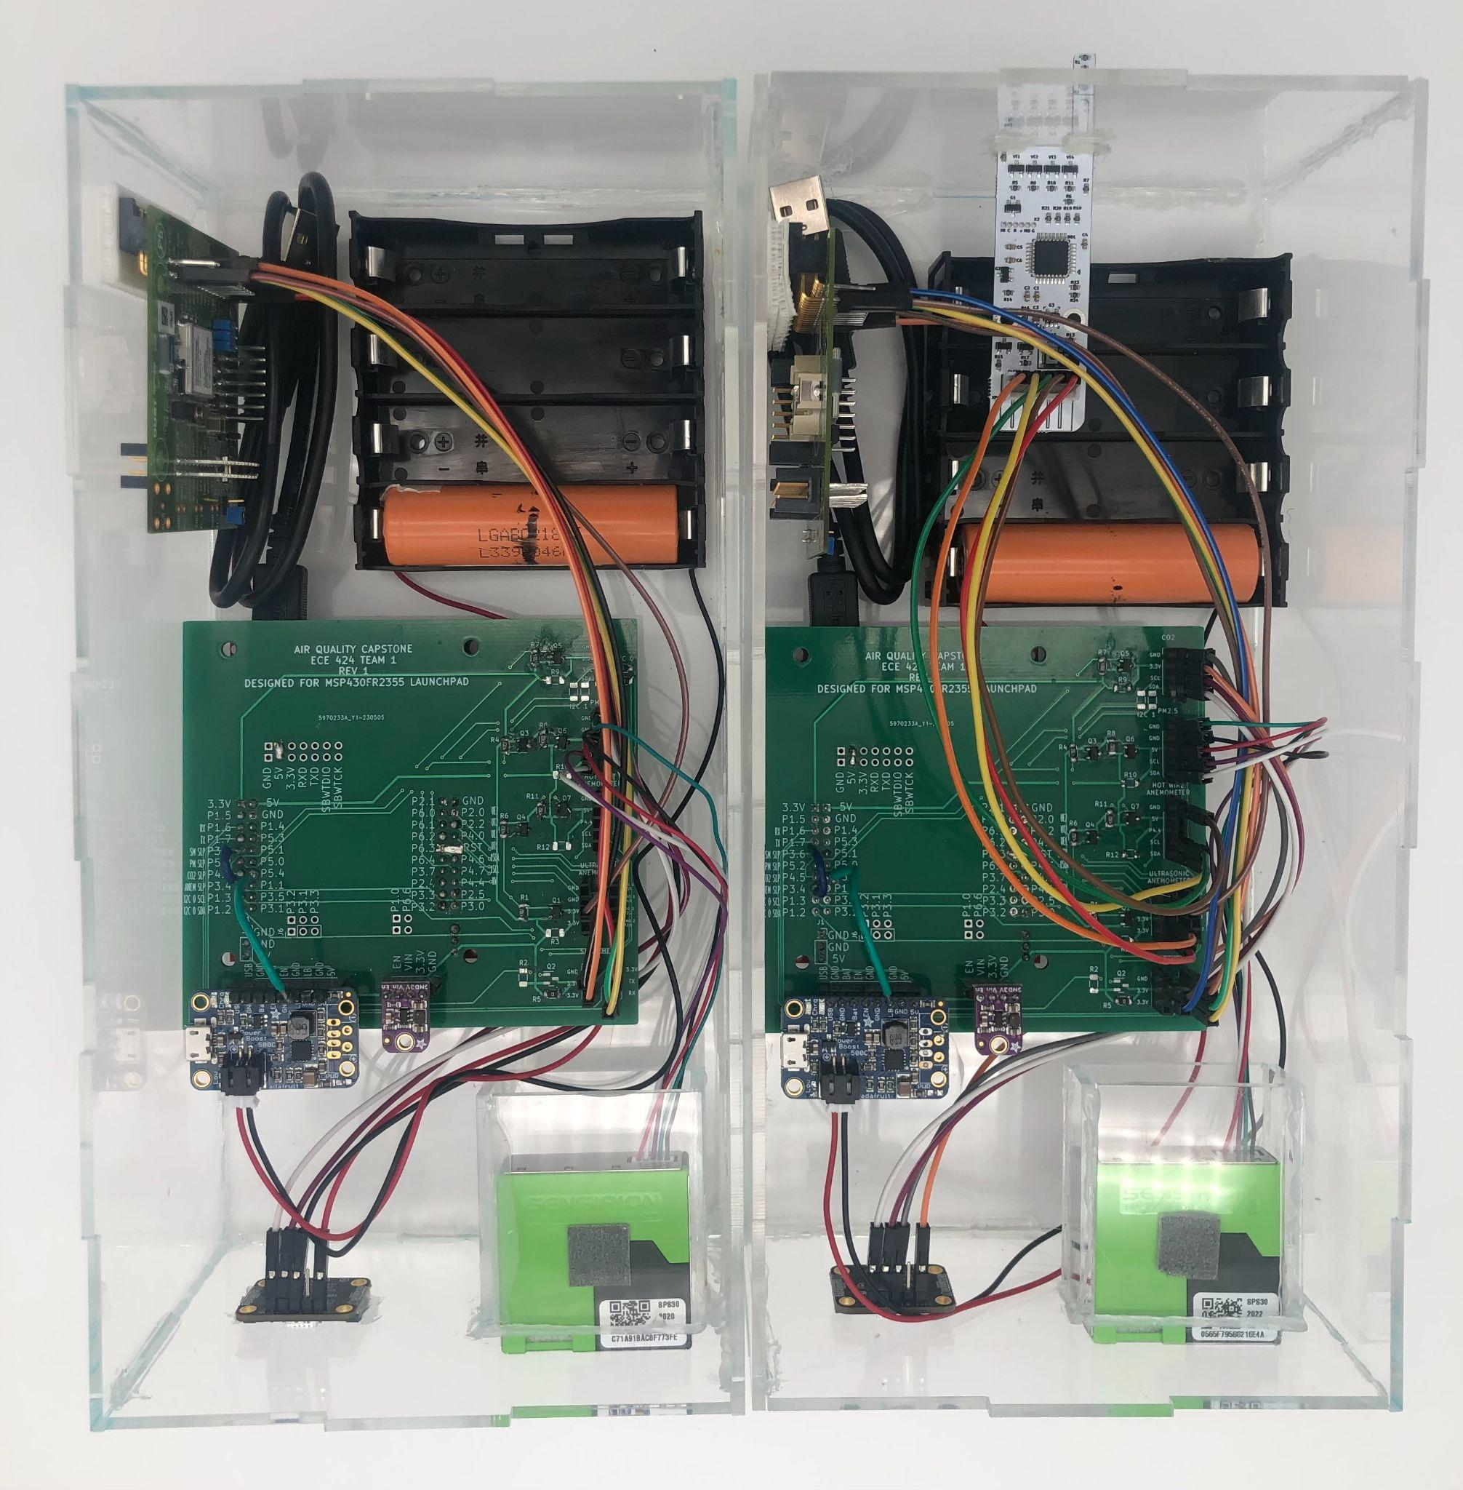
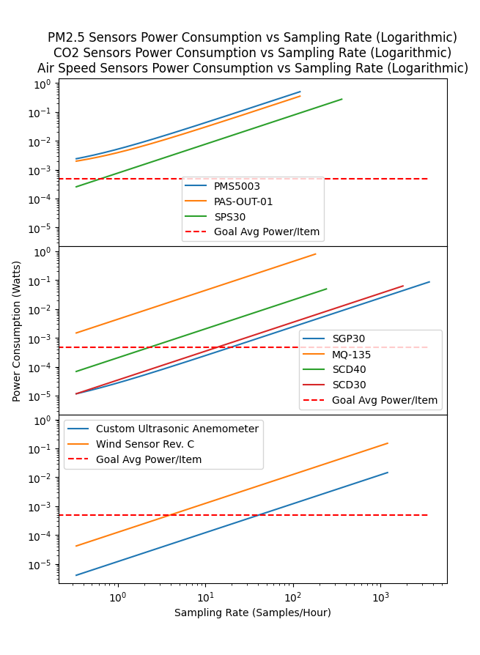
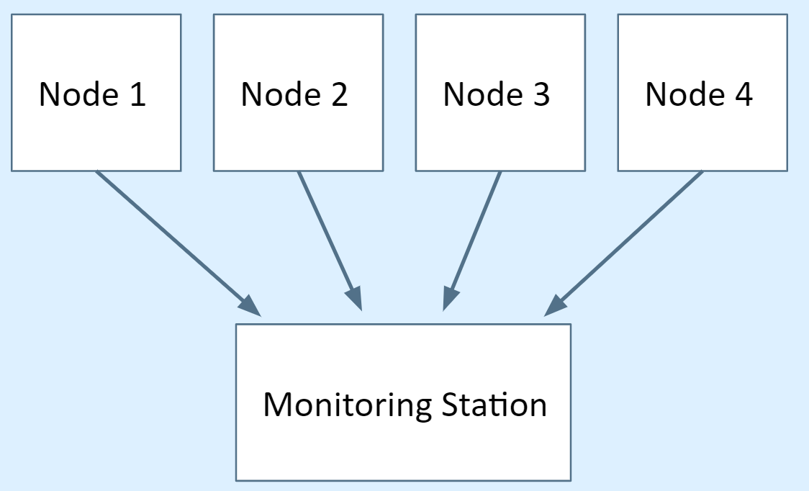
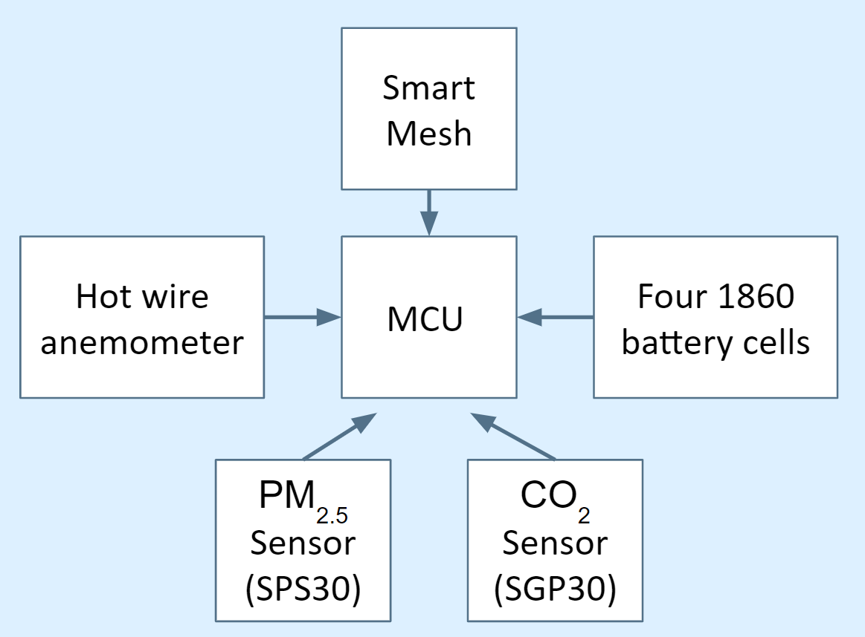


Open-Source Wireless Sensor System For Indoor Air Quality Monitoring
Team: Adam A. Dezay, Brandon P. Hippe, Manuel A. Garcia, Mercedes C. Newton Faculty Advisor: John M. Acken Industry Sponsor: David C Burnett
Objective: Our team built four wireless, battery powered devices to monitor elevated quantities of CO₂ (Carbon Dioxide) and PM_{2.5} (Particulate Matter) as well as air speed utilizing commercial off-shelf components and open-source software for easy replication.
Air Quality
Design Implementation
The quality of the air we breath intimately impacts our health yet is rarely monitored in indoor spaces. The quantity of CO₂ is measured in parts per million (PPM) meaning the concentration of said contaminant in relation to a million parts measured. PM_{2.5} is measured in ug/m³ . Any volume of CO₂ over 1000 PPM is considered harmful. Any volume of PM_{2.5} greater than 12 ug/m³ is considered harmful. Elevated levels of these contaminants can have detrimental effects on our health as well as our ability to focus.
We simplified our design by creating a “Hat” for the MSP430. We made some modifications on top of our final design using jumper wires above and below. Pictured is the adaptation to our board, however our finalized and published PCB CAD file (shown to the right) has these modifications taken into account. When designing our enclosure it was important to leave ample space between the sensors (placed at the bottom of the enclosure) and the anemometer and battery (placed at the top of the enclosure) in order to ensure heat would not affect our readings.
Pre-Existing Design
Our research and design builds upon the work of Dr. Burnett's previous capstone team. Last years team utilized the MSP430 and SmartMesh technology to record N₂O (Nitrous Oxide), temperature and humidity outdoors. Our team built upon the previous teams knowledge of the MSP430 and SmartMesh technology, this time employing it for an indoor application.
Power Consumption
Final Product
Our modules are battery powered for user ease. Our team studied the power consumption of each sensor before selecting in order to ensure the longest possible battery life. To the left is a graph that demonstrates the power consumption of each sensor. After sensors were selected, we calculated how frequently we could measure data with each sensor in relation to how long the battery life would then be.
We developed one unit with a hot wire anemometer and three units without anemometers. Pictured is two of our final modes, with the anemometer node pictured on the right and a node without the anemometer to its left. Our systems are running as expected, and a graph of some data from various labs at PSU is shown below. These devices communicate with each other using SmartMesh IP. Our team satisfied all requirements placed by our faculty advisor and created a product that will hopefully be used at PSU for years to come.
Design Overview
Our major focuses when designing this sensor system were creating modules that were power efficient, accurate and affordable. With this in mind we decided to use the Senserion SPS30 PM_{2.5} sensor and the Senserion SPG30 CO₂ sensor. We attempted to design an ultrasonic anemometer, as it would be far less power hungry, but ultimately we were unable to salvage this idea and pivoted to utilizing the Wind Sensor Rev. C hot wire Anemometer. This anemometer consumes a lot of power and also produces a lot of heat, which made implementing it challenging.
Sensor | 3 Months Battery Life | 6 Months Battery Life | 1 Year Battery Life
CO₂ | 8.5 min (510 sec) | 18 min (1080 sec) | 37 min (2220 sec)
PM_{2.5} | 16 min (960 sec) | 34 min (2040 sec) | 72 min (4320 sec)
Table: Component Measurement Periods for 3 month, 6 month, and 1 year battery life for units without anemometer
Sensor | 3 Months Battery Life | 6 Months Battery Life | 1 Year Battery Life
CO₂ | 40 min (2400 sec) | 90 min (5400 sec) | 220 min (13200 sec)
PM_{2.5} | 47 min (2820 sec) | 110 min (6600 sec) | 260 min (15600 sec)
Hot Wire Anemometer | 16 min (960 sec) | 36 min (2160 sec) | 86 min (5160 sec)
Table 2: Component Measurement Periods for 3 month, 6 month, and 1 year battery life for units with hot wire anemometer
Department of Electrical and Computer Engineering
Visit our website for more information!
URL
Notes:
This is just a template. Modify it to your heart’s content, and especially modify it if sections do or don’t apply to your capstone! This poster is about telling the story of your capstone - what were you asked to do, what did you come up with, what did you do, and how did it go?

Slide 2
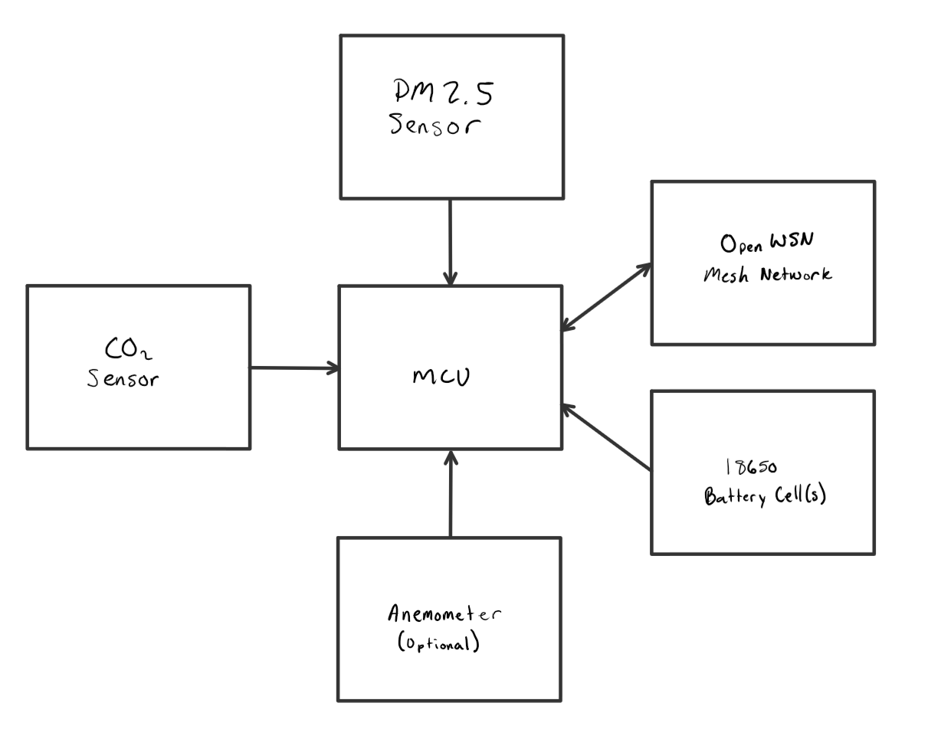
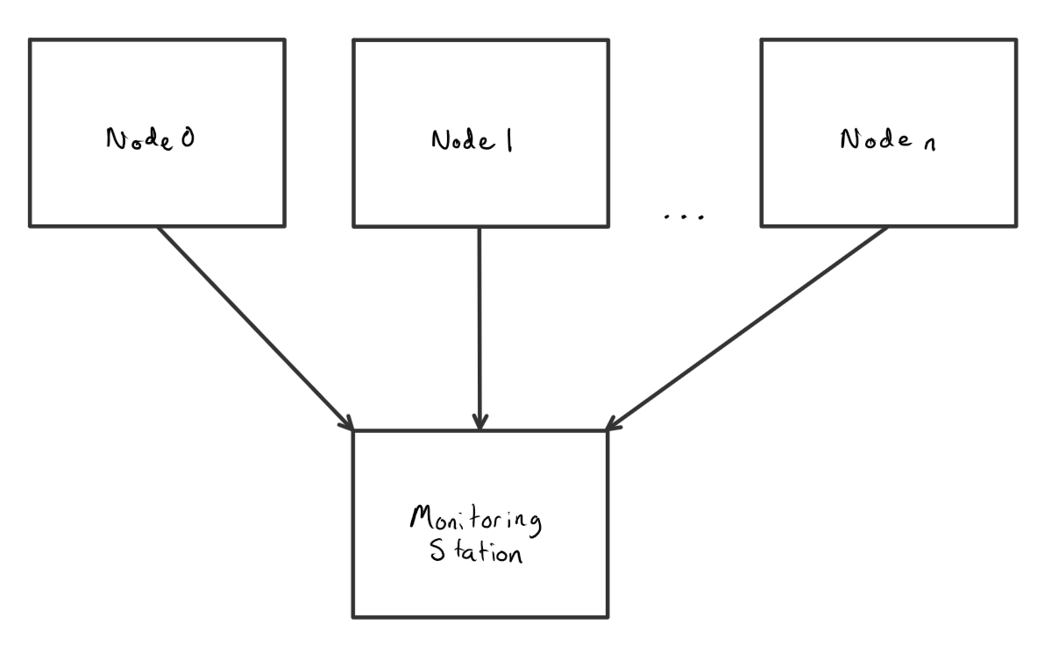
Open-Source Wireless Sensor System For Indoor Air Quality Monitoring
Team: Adam A. Dezay, Brandon P. Hippe, Manuel A. Garcia, Mercedes C. Newton Faculty Advisor: John M. Acken Industry Sponsor: David C Burnett
Objective: Our team built four wireless, battery powered devices to monitor elevated quantities of CO₂ (Carbon Dioxide) and PM 2.5 (Particulate Matter) as well as air speed utilizing commercial off-shelf components and open-source software for easy replication.
Air Quality
Below is a photo of two of our final modes, with the anemometer node pictured on the right and a node without the anemometer to its left.
We developed one unit with the hot wire anemometer and three units without anemometers.Below is a photo of two of our final modes, with the anemometer node pictured on the right and a node without the anemometer to its left.
Power Dsign
Smart Mesh
Node 1
Node 2
Node 3
Node 4
Hot wire anemometer
MSP430
Four 18650 battery cells
Monitoring Station
PM2.5 Sensor (SPS30)
CO₂ Sensor (SGP30)
Design
Our major focuses when designing this sensor system were creating modules that were power efficient, accurate and affordable. With this in mind we decided to use the Senserion SPS30 PM2.5 sensor and the Senserion SPG30 CO2 sensor. We attempted to design an ultrasonic anemometer, as it would be far less power hungry, but ultimately we were unable to salvage this idea and pivoted to utilizing the Wind Sensor Rev. C Hot wire Anemometer. This anemometer consumes alot of power and also produces alot of heat, which made implementing it challenging. We developed one unit with the hot wire anemometer and three units without anemometers.
Department of Electrical and Computer Engineering
Notes:
This is just a template. Modify it to your heart’s content, and especially modify it if sections do or don’t apply to your capstone! This poster is about telling the story of your capstone - what were you asked to do, what did you come up with, what did you do, and how did it go?

Slide 3
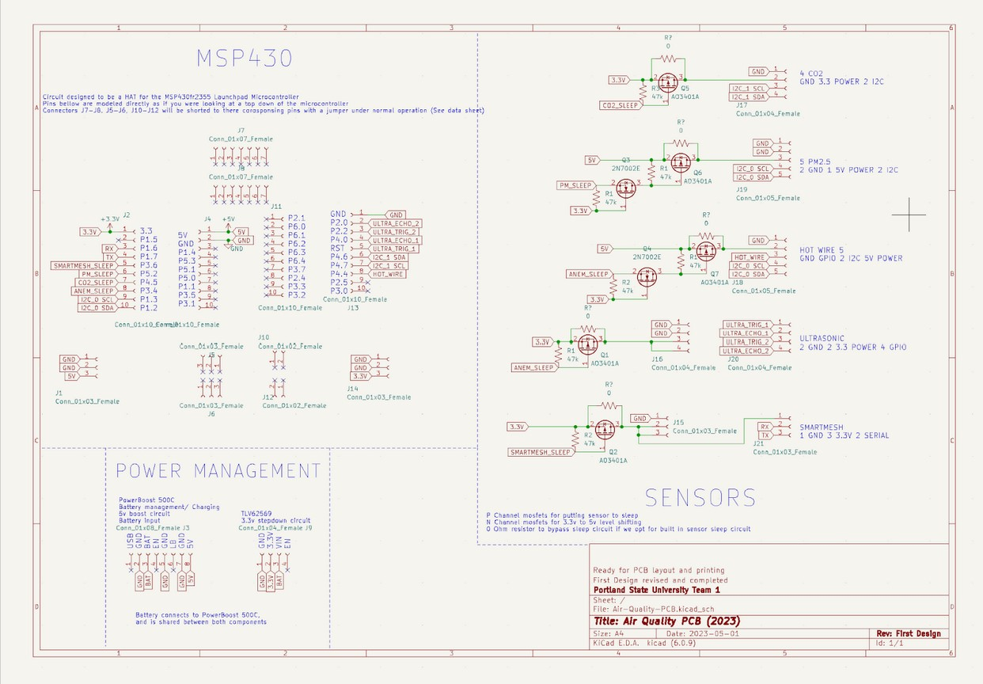

Slide 4
DO NOT EDIT FOLLOWING SLIDE

Slide 5
Open-Source Wireless Sensor System For Indoor Air Quality Monitoring
Team: Adam A. Dezay, Brandon P. Hippe, Manuel A. Garcia, Mercedes C. Newton Faculty Advisor: John M. Acken Industry Sponsor: David C Burnett
Objective: Our team built four wireless, battery powered devices to monitor elevated quantities of CO₂ (Carbon Dioxide) and PM_{2.5} (Particulate Matter) as well as air speed utilizing commercial off-shelf components and open-source software for easy replication.
Air Quality
Design Implementation
The quality of the air we breath intimately impacts our health yet is rarely monitored in indoor spaces. The quantity of CO₂ is measured in parts per million (PPM) meaning the concentration of said contaminant in relation to a million parts measured. PM_{2.5} is measured in ug/m³ . Any volume of CO₂ over 1000 PPM is considered harmful. Any volume of PM_{2.5} greater than 12 ug/m³ is considered harmful. Elevated levels of these contaminants can have detrimental effects on our health as well as our ability to focus.
We simplified our design by creating a “Hat” for the MSP430. We made some modifications on top of our final design using jumper wires above and below. Pictured is the adaptation to our board, however our finalized and published PCB CAD file (shown to the right) has these modifications taken into account. When designing our enclosure it was important to leave ample space between the sensors (placed at the bottom of the enclosure) and the anemometer and battery (placed at the top of the enclosure) in order to ensure heat would not affect our readings.
Pre-Existing Design
Our research and design builds upon the work of Dr. Burnett's previous capstone team. Last years team utilized the MSP430 and SmartMesh technology to record N₂O (Nitrous Oxide), temperature and humidity outdoors. Our team built upon the previous teams knowledge of the MSP430 and SmartMesh technology, this time employing it for an indoor application.
Power Consumption
Final Product
Our modules are battery powered for user ease. Our team studied the power consumption of each sensor before selecting in order to ensure the longest possible battery life. To the left is a graph that demonstrates the power consumption of each sensor. After sensors were selected, we calculated how frequently we could measure data with each sensor in relation to how long the battery life would then be.
We developed one unit with a hot wire anemometer and three units without anemometers. Pictured is two of our final modes, with the anemometer node pictured on the right and a node without the anemometer to its left. Our systems are running as expected, and a graph of some data from various labs at PSU is shown below. These devices communicate with each other using SmartMesh IP. Our team satisfied all requirements placed by our faculty advisor and created a product that will hopefully be used at PSU for years to come.
Design Overview
Our major focuses when designing this sensor system were creating modules that were power efficient, accurate and affordable. With this in mind we decided to use the Senserion SPS30 PM_{2.5} sensor and the Senserion SPG30 CO₂ sensor. We attempted to design an ultrasonic anemometer, as it would be far less power hungry, but ultimately we were unable to salvage this idea and pivoted to utilizing the Wind Sensor Rev. C hot wire Anemometer. This anemometer consumes a lot of power and also produces a lot of heat, which made implementing it challenging.
Sensor | 3 Months Battery Life | 6 Months Battery Life | 1 Year Battery Life
CO₂ | 8.5 min (510 sec) | 18 min (1080 sec) | 37 min (2220 sec)
PM_{2.5} | 16 min (960 sec) | 34 min (2040 sec) | 72 min (4320 sec)
Table: Component Measurement Periods for 3 month, 6 month, and 1 year battery life for units without anemometer
Sensor | 3 Months Battery Life | 6 Months Battery Life | 1 Year Battery Life
CO₂ | 40 min (2400 sec) | 90 min (5400 sec) | 220 min (13200 sec)
PM_{2.5} | 47 min (2820 sec) | 110 min (6600 sec) | 260 min (15600 sec)
Hot Wire Anemometer | 16 min (960 sec) | 36 min (2160 sec) | 86 min (5160 sec)
Table 2: Component Measurement Periods for 3 month, 6 month, and 1 year battery life for units with hot wire anemometer
Department of Electrical and Computer Engineering
Visit our website for more information!
URL
Notes:
This is just a template. Modify it to your heart’s content, and especially modify it if sections do or don’t apply to your capstone! This poster is about telling the story of your capstone - what were you asked to do, what did you come up with, what did you do, and how did it go?

